Slide 1
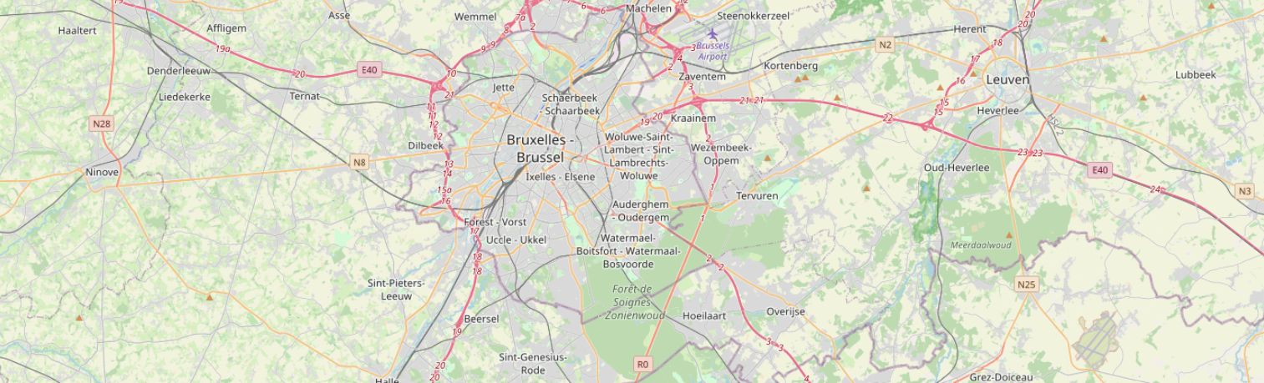
Segmenting and Clustering banking Neighborhoods in Brussels using Python
Prister, Miriam
Lara Zenozain, Luis Miguel

Slide 2
Introduction & Business Problem
One thing that is currently missing from our databases is an interactive map
In this POC we create a map showing the location of banks and bank branches in Brussels. This could also be applied for larger regions covered in our products and different kinds of entities.
We chose banks as this type of analysis could be of interest to our customers as there are different studies/analyses done on branch locations by banking institutions.
This would allow banks (and other entities or costumers) to study where they could locate
We also added markdowns based on the specific research from our clients, these markdowns, in our example for KBC banks, allows us to see the specific locations of our bank. This a useful visualization tool.

Slide 3
Model description: Segmenting and Clustering banking Neighborhoods in Brussels
A quick search on Orbis gives us the following data:
Number of active banks in Brussels: 469
of which 293 are branches
We will use Foursquare API to explore neighborhoods in Brussels and get different information on our entities of interest such as:
Name
Address
Category
Etc.
We use the explore function to get all banks in each neighborhood.
Search for a specific venue category using the API:
https://api.foursquare.com/v2/venues/search?client_id=CLIENT_ID&client_secret=CLIENT_SECRET&ll=LATITUDE,LONGITUDE&v=VERSION&query=QUERY&radius=RADIUS&limit=LIMIT
Due to limitations on our foursquare API's permissions we are only able to get the data for 50 banks in Brussels. We will divide these entities in 5 different geographical clusters to have a better visualization of our data.
Here we will convert addresses into their equivalent latitude and longitude values and use the Foursquare API to explore banks in Brussels.
We will then group the banks into clusters by using the k-means clustering algorithm to complete this task.
Finally, we will use the Folium library to visualize the banks in Brussels and their emerging clusters.

Slide 4
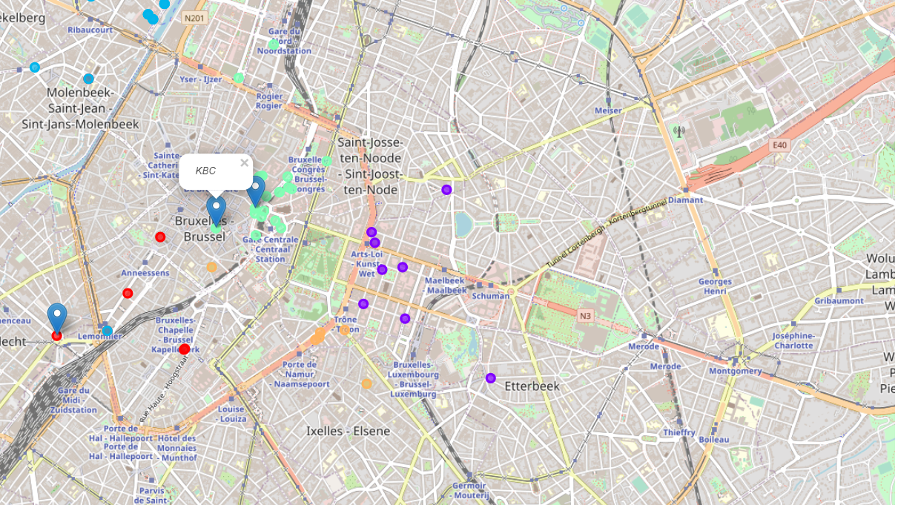
Results
Divided in different clusters based on their neighborhood (each cluster with its specific color)
Markers showing the location of our entities of interest, in our example
Labelling: if you click on the dots and markers you can get the available information from the data frame such as:
Name
Address
Revenues
Etc.

